Slide 1
VLMs for Autonomous Battle Damage Assessment (BDA)
End-Phase I
FEB 9, 2026

Slide 2
VLMs for Autonomous Battle Damage Assessment
Project Overview:
Background
Data Engineering
Modeling
Software Design
Challenges
Team Members:
William Benitez: Prompt Engineer
Carlos Gil: Software Developer
Nicholas Lind: Data Engineer
Benjamin Siegel: ML Engineer
Cory Wingate: Project Manager/DevOps
AI2C Scholar and Mentors:
Jesse Barkley: AI Scholar
Derrik Asher: Army Research Lab
Jason Pusey: Army Research Lab

Slide 3
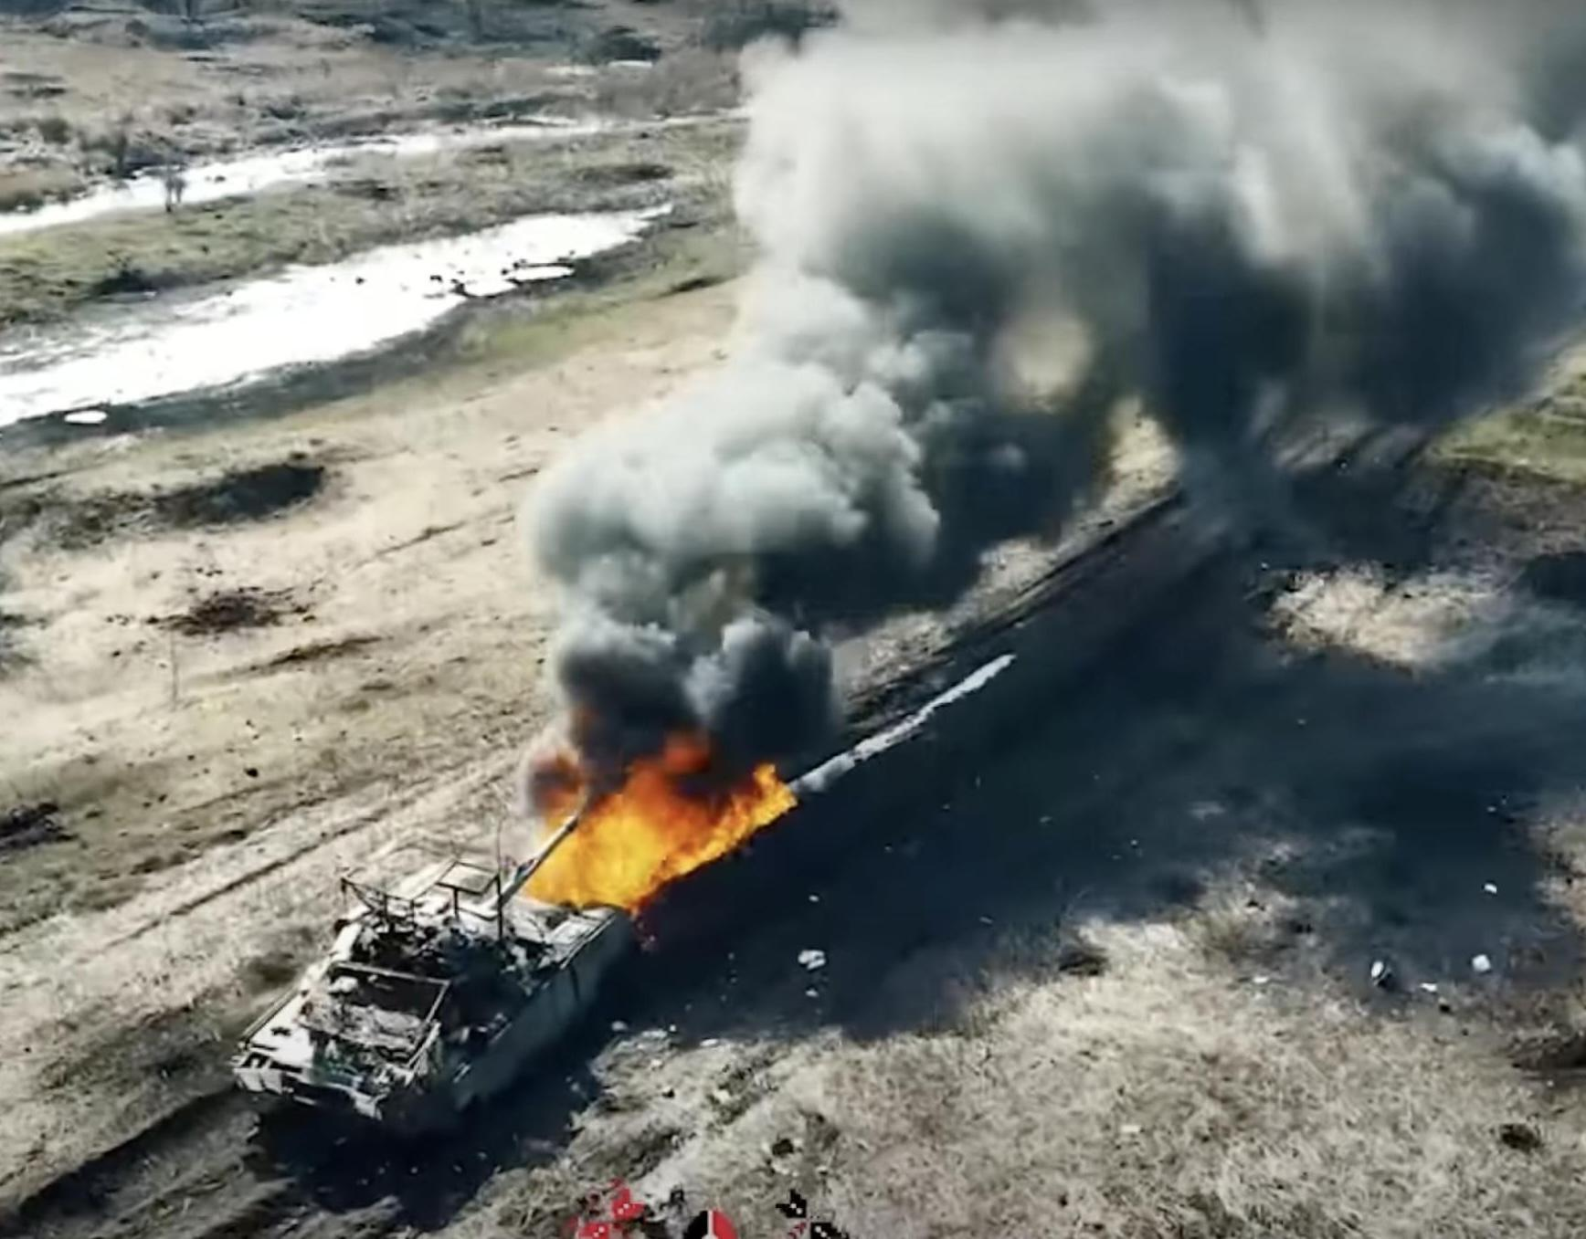
Background
A Battle Damage Assessment (BDA) “provides the timely and accurate estimate of damage resulting from the application of lethal and nonlethal military force.”
(Methodology for Combat Assessment - Joint Staff)
Requires Human Analyst
Slow
Dangerous
Inconsistent, Not Standardized

Slide 4
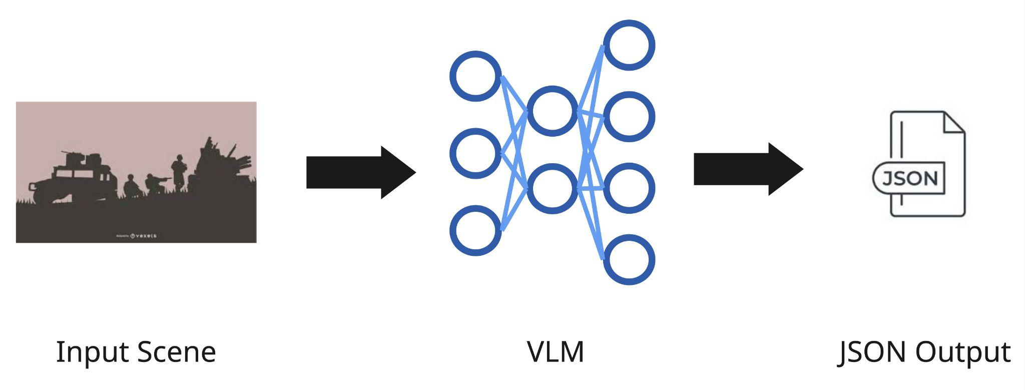
Background - Current Methodology
Problem #1: Vague doctrinal adherence
Problem #2: How good is the model?
Problem #3: Jupyter Notebooks…

Slide 5
Proposed Solution
We are objectively evaluating VLM-generated BDAs using open-source data, as well as developing a portable environment to create VLM-generated BDAs on edge devices operating within research environments.

Slide 6
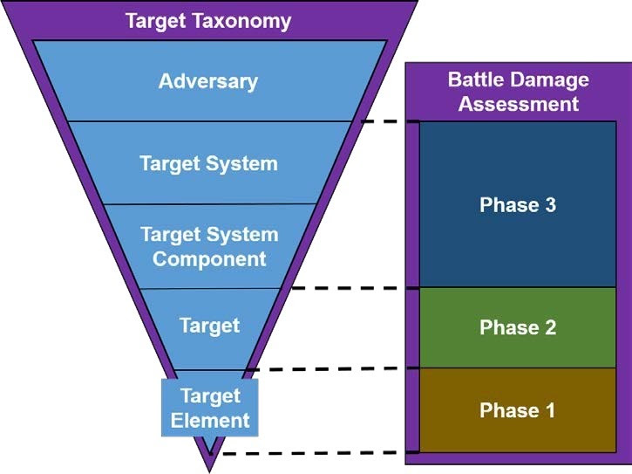
Data Requirements For BDA
Target-Element Level
Damage Category
Confidence Level
“One vehicle is assessed as DESTROYED (CONFIRMED)”

Slide 7
Data Requirements For BDA
Scene Level
Functional Damage Level
“The target is assessed as having SEVERE FUNCTIONAL DAMAGE, indicating a significant degradation in its ability to perform its intended mission.”

Slide 8
Data Requirements For BDA
Recuperation Time
Re-Attack Rec.
Task Assessment
Requires Mission Context (OPORD)
Notes:
nick

Slide 9
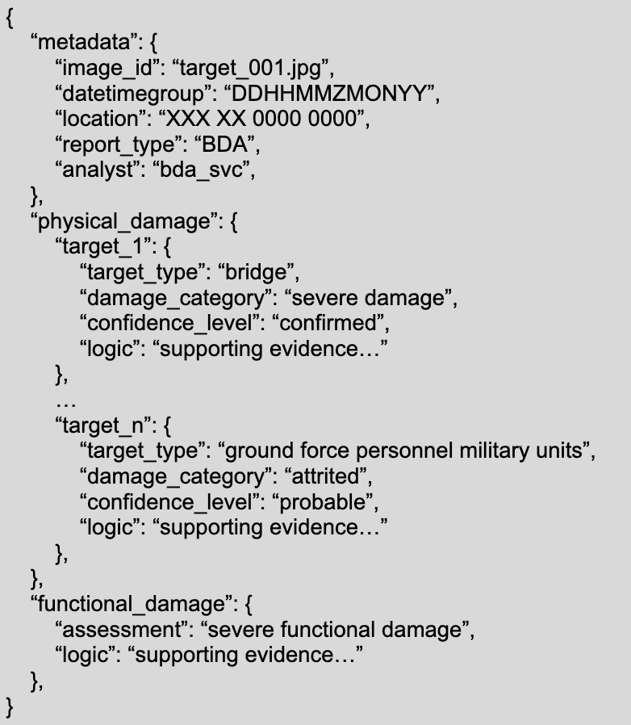
Data
Notes:
Our system automates Phase 1 of the BDA process and includes limited Phase 2 functionality when the image supports it. This slide shows that transformation: raw image in, structured JSON assessment out, with categories, labels, and confidence scores

Slide 10
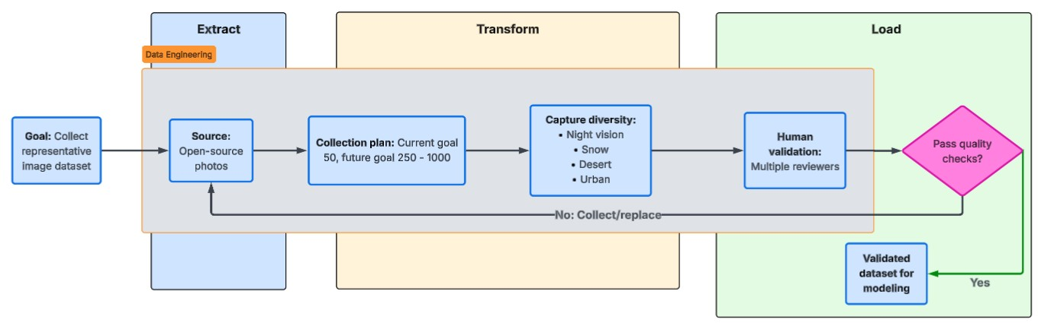
Data
Notes:
The goal is to collect representative data reflecting real world conditions, variations and edge cases the model will face. Pictures will come from everywhere, drone, satellite, ground-level, as well as different zoom and distances.
The current collection goal is 50 images, however we intend to expand to at least 250 and reach greater heights around the 1000 image mark.
The pictures we are collecting will be diverse and will show different situations that can simulate the chaotic nature of war.
Finally we as a group will validate the images and grade them, to allow a baseline criteria.

Slide 11
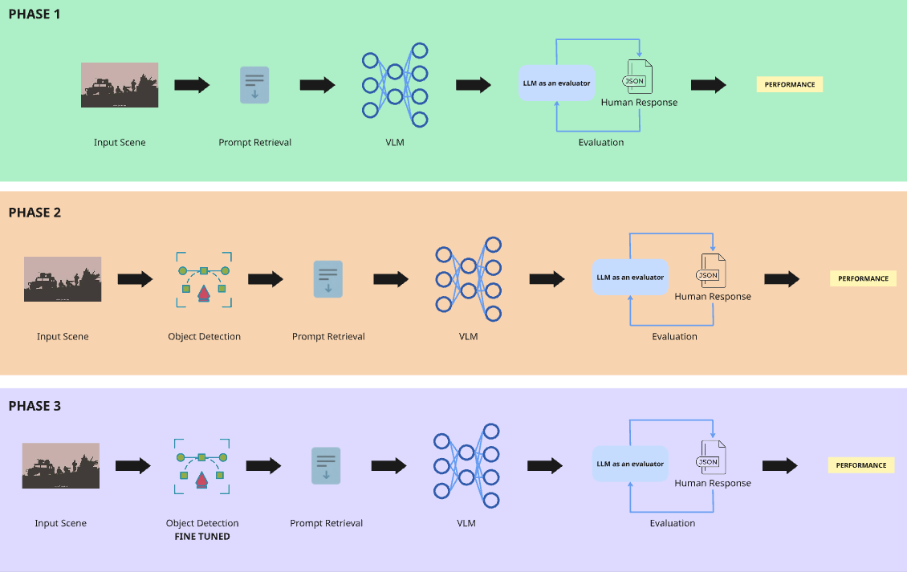
Modeling

Slide 12
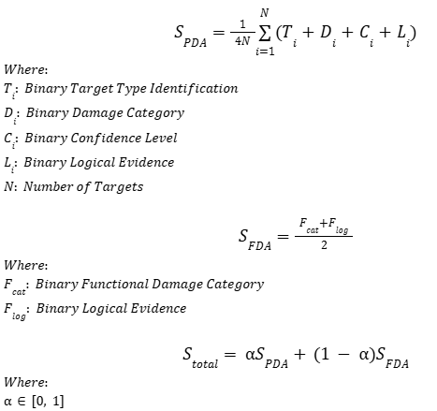
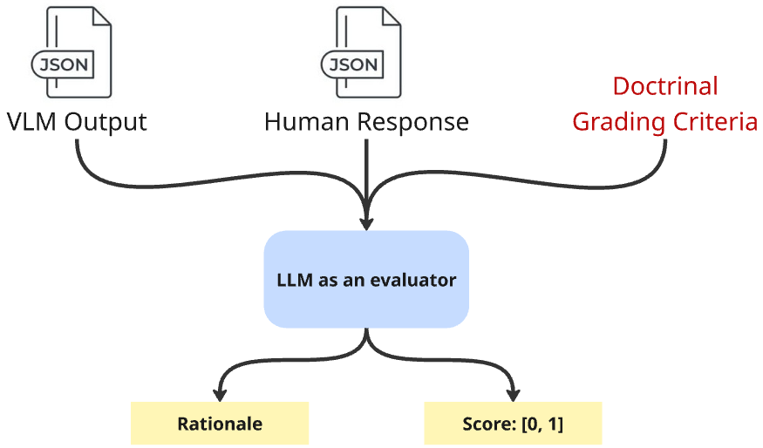
Evaluation

Slide 13
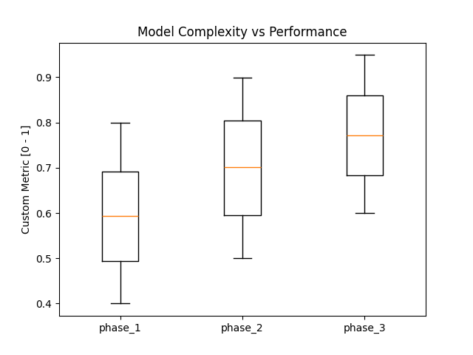
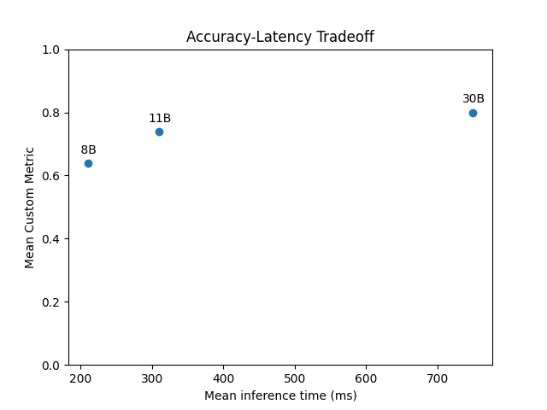
Results

Slide 14



Software Deliverable
Robotic Platform
Executable / CLI
Validate + Access
Preprocess Targets
VLM Output
Store
Self-contained with software and model
Read input folder
Write output folder
Prompt input
BDA Analysis
JSON Output
Docker Runtime
NVIDIA Jetson

Slide 15
Challenges
No publicly available labeled dataset
Limited access to robotic platform
Edge platform hardware limits

Slide 16
Questions?

Slide 17
Hidden Slides

Slide 18
BDA Pipeline - Process Flow Diagram
Local Dev Environment
Research / Testing
CLI + Config
Validate Input
Preprocess
VLM Analysis
JSON Output
Iterate to validate
end-to-end behavior
• Start VLM-only baseline
• Then add object detection
• Refine prompts/templates
Select VLM + prompt
via text config
Folders + usage
JPG/PNG/GIF/TIFF
Object extraction
Quality checks
Log & continue
Assess physical +
functional damage
Report: date, model,
damage, confidence,
observations, images
Robotic Platform
Deployed
Executable / CLI
Validate + Access
Preprocess Target
VLM Target
Persist + Retrieve
Production execution
Constraints
• .py file or container image
• No network required
• Console progress %
Linux
system-wide
Read input folder
Write output folder
< 3s / image
(preprocessing)
< 15s / image
16 GB VRAM
Standards JSON
No overwrite/delete
Retrieve via CLI arg
Inputs & Configuration
Outputs
Edge Cases & Constraints
CLI args: usage, input folder, output folder
Validate data presence + formats
Choose VLM + prompt via text config
JSON report + supporting imagery
Notify user + output location
Retrieval mode for completed assessments
Invalid/corrupt → notify; continue or re-run
Low confidence → flag; manual review/reprocess
System failure → log; alert admin; retry later
Offline, no external deps, ≤ 20 GB footprint

